Slide 1
Chapter 6
Programming
Problem solving
Debugging

Slide 2
Problem solving
Start with systematic decomposition of problem
  “top-down” analysis
  stepwise refinement
Algorithms must have properties of:
  finiteness
  completeness
  definiteness
  computability

Slide 3
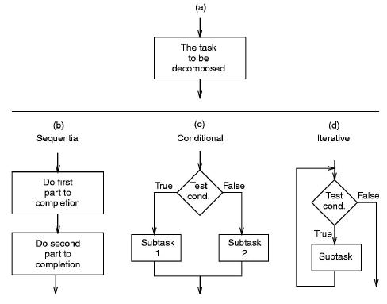
Structured programming
Three control structures:
  Sequential
    This is the default
  Conditional
    Branching or decision-making
  Iteration
    Loops

Slide 4
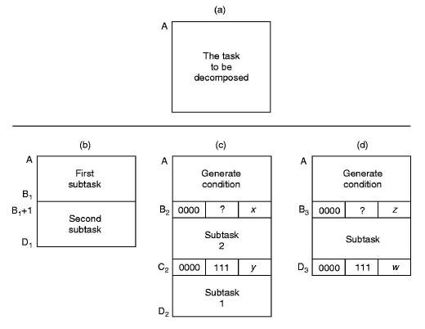
Implementing the control structures
  Sequential Conditional Iterative

Slide 5
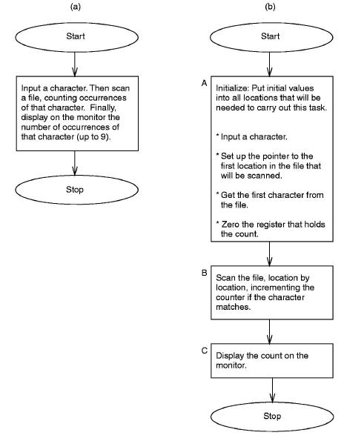
Stepwise refinement illustrated
Character count algorithm:
  statement of problem & first level of refinement

Slide 6
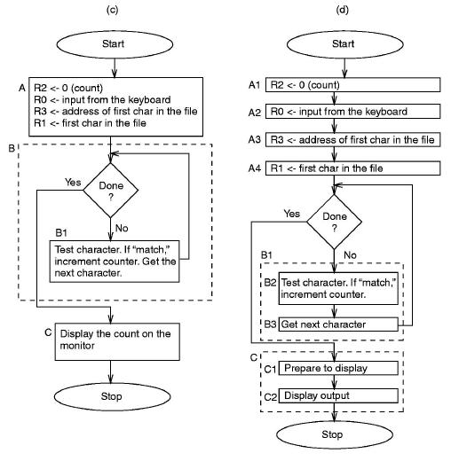
Stepwise refinement (cont.)
  2nd & 3rd levels

Slide 7
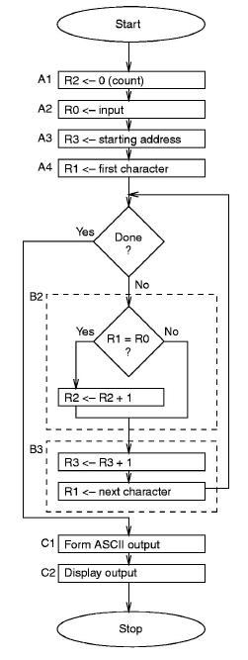
Stepwise refinement (cont.)
  Final level

Slide 8
Debugging
A debugging tool provides (at least) the ability to:
  Set values to registers & memory locations
    enter as hex, decimal or binary values
  Execute instructions one at a time, or in small groups
    Run will set the program running
    Step causes a fixed number of instructions to be executed
    (often used to “single-step” through part of a program)
  Stop execution when desired
    Breakpoints allow the user to set points at which execution
    will halt & wait for a new “Run” instruction
  Examine the contents of registers and memory locations
  at any point

Slide 9
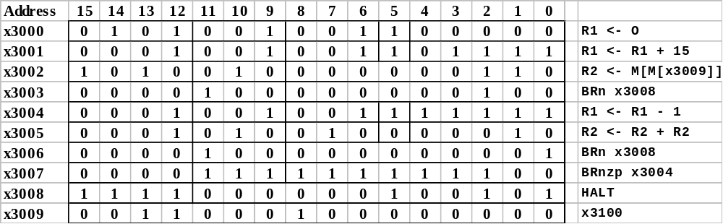
Debugging example
A program to find the first 1 in a 16-bit word

Slide 10
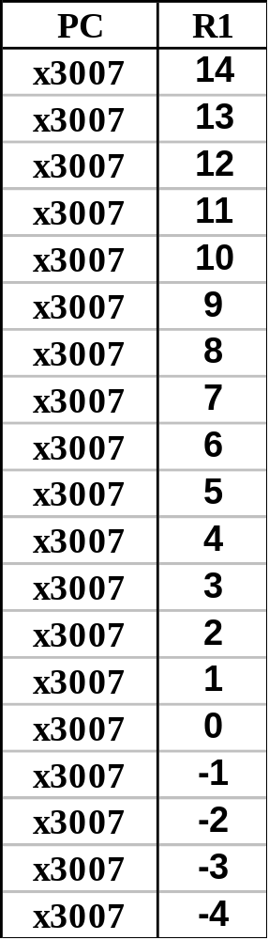
Debugging example (cont.)
  Oops! We have an infinite loop!
      Setting a breakpopint at location x3007 & repeatedly running the code shows that the loop does not trerminate because there is no 1 in the test case number

